Slide 1
Natural Language Inference

Slide 2
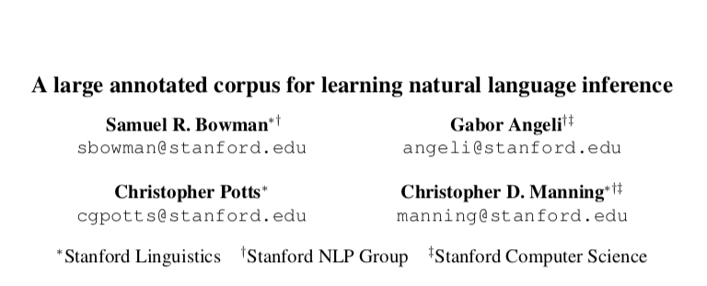

Slide 3
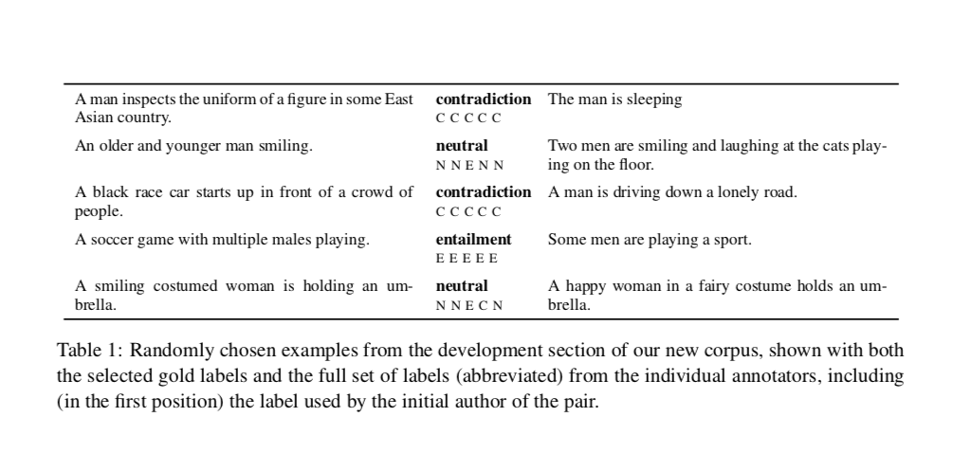

Slide 4
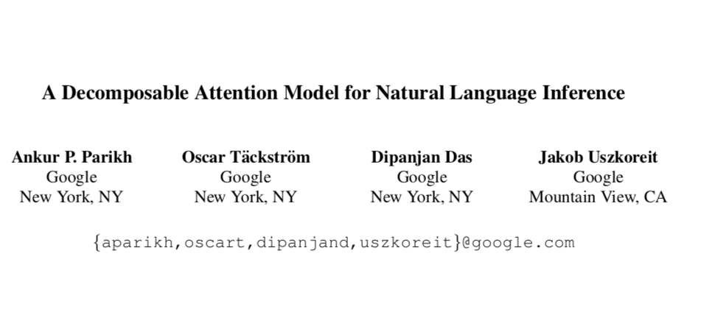

Slide 5
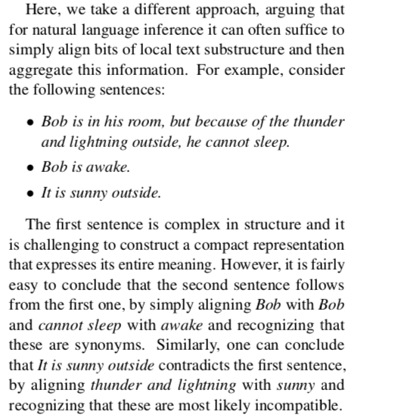

Slide 6
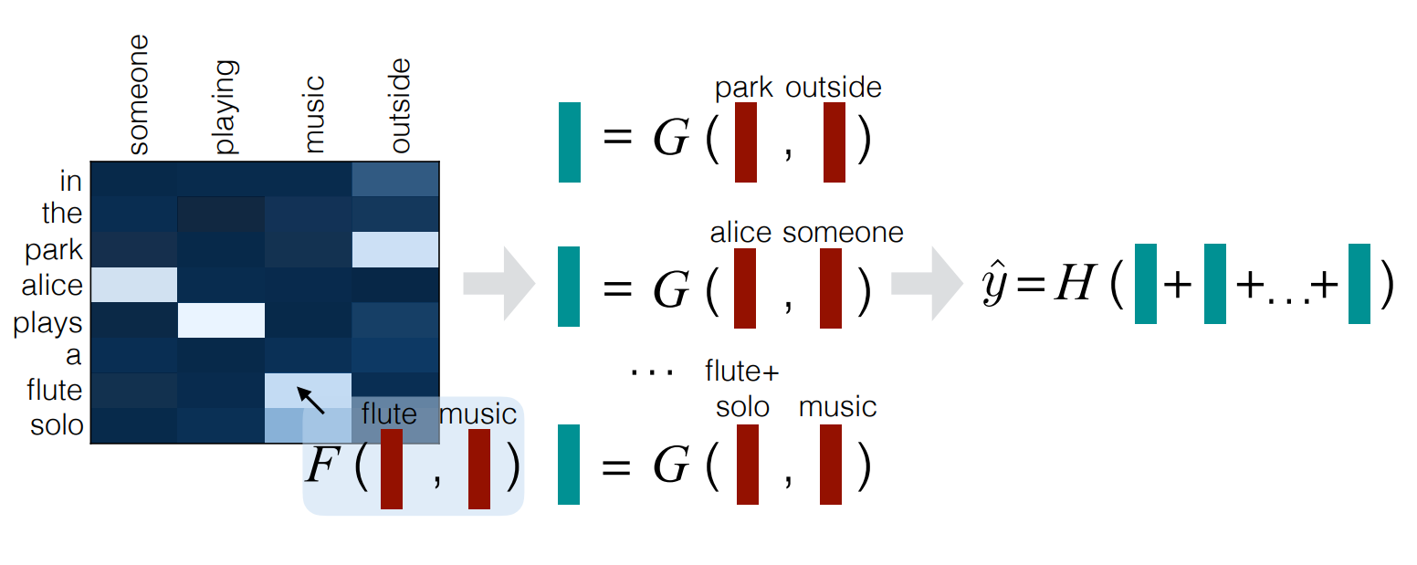
Decomposable Attention
1. Attend 2. Compare 3. Aggregate

Slide 7


Step 1: Attend

Slide 8
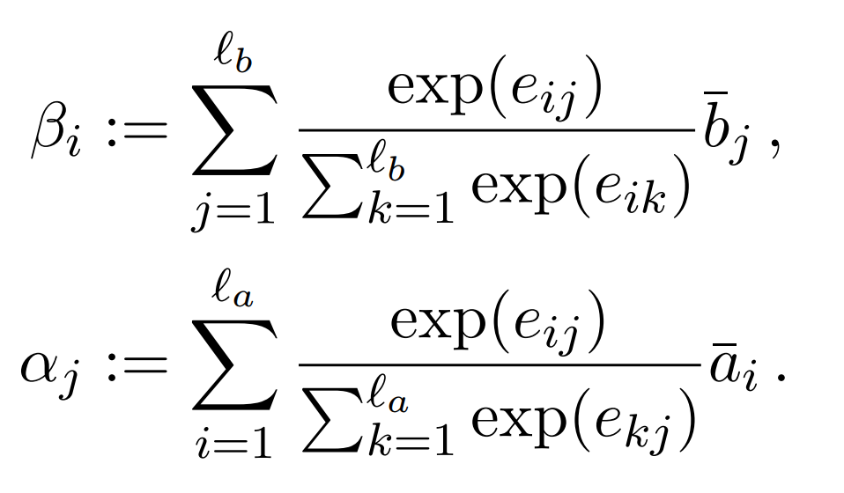
Step 1

Slide 9

Step 2: Compare

Slide 10


Step 3: Aggregate

